Slide 1
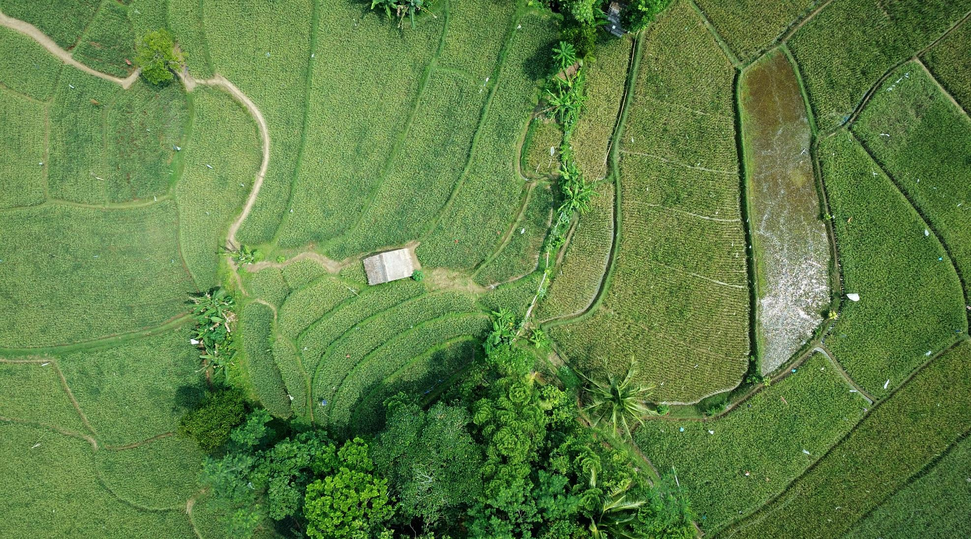

Demystifying ML: US Climate Change
Team Slack-Errr:
Hayden Rubin, Craig Nowakowski & Nick Nasse

Slide 2
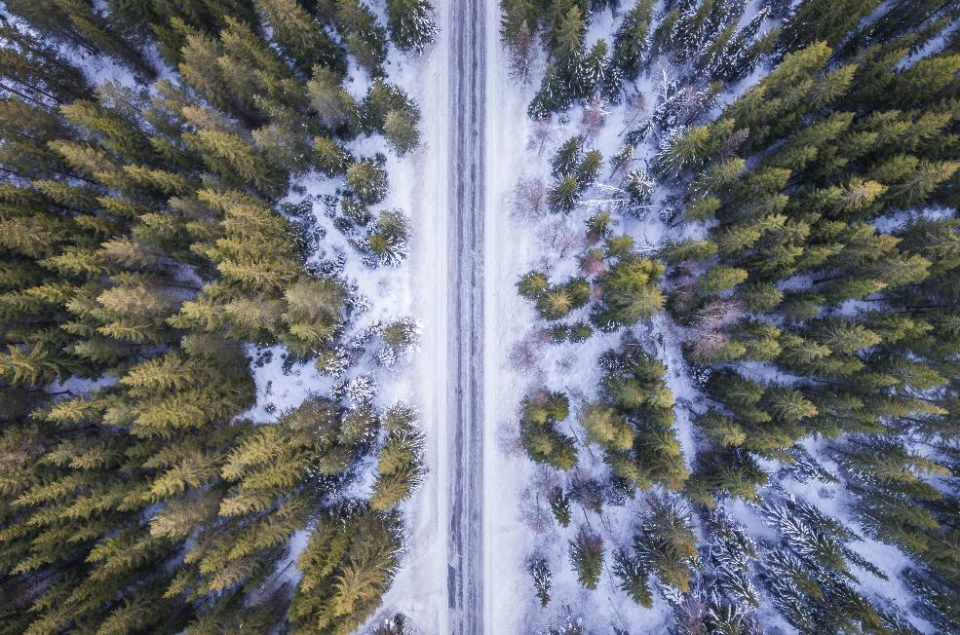
US Climate Change
“In America, one's view of climate change often depends on where they live. The majority of U.S. adults say they are taking some specific action in their daily lives to protect the environment and that 62% say climate change is at least having some impact on their local community. Most Pacific states followed by the Northeast see climate change as affecting their local areas.”
[PEW Research Center, 11/22/2019.]
Using climate data from 1975-2016 and Machine Learning to evaluate the potential effects of climate change on states across the US.

Slide 3





Tech & Data Flow
Database: Google BigQuery
Notebook: Google Colab
Data Cleaning: Pandas
Machine Learning: PySpark ML
Visualization: Tableau
Cloud Data Warehouse, which is queried using SQL*
Hosted Jupyter notebook for running Python on the cloud*
Python Library for Data Manipulation & Analysis*
Package combining Python / Apache Spark for Machine Learning on Big Data*
Business Intelligence and Data Visualization Tool*
*Technology that satisfies final project requirement

Slide 4


Data Sets
NOAA GSOD
Mauna Loa
kaggle.com/noaa/gsod
kaggle.com/ucsandiego/carbon-dioxide
National Oceanic and Atmospheric Administration (NOAA) is an American scientific agency that charts the conditions of the oceans and atmosphere
Their Global Surface Summary of the Day (GSOD) dataset compiles daily weather data, including daily avg temp (F) from now 9,000 weather stations across the world with data dating back to 1929.
Mauna Loa Observatory (MLO) is a premier atmospheric research facility that has been continuously monitoring and collecting data related to atmospheric change since the 1950’s.
The Keeling Curve dataset is a measurement of the accumulation of carbon dioxide in the Earth's atmosphere (ppm) based on continuous measurements taken at Mauna Loa

Slide 5

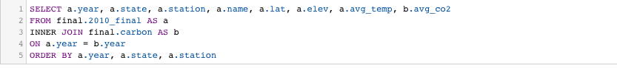
Data Prep
Using SQL within BigQuery, we:
Took the weather stations’ daily average temperature readings and computed the stations’ yearly averages (F)
Took the Mauna Loa monthly atmospheric carbon dioxide readings and computed the yearly averages (PPM)
Combine the yearly average temperature and carbon dioxide datasets, so they could easily be read into PySpark for ML and Tableau for Visualizations
*dropped nulls and stations that didn’t have 12months of readings for the computed year.

Slide 6

Visualizations: Historical Data
https://public.tableau.com/profile/nick.nasse#!/vizhome/USCapitalsTempPredictions/USClimateChange

Slide 7
ML: Training & Testing
Algorithm
Inputs
Summary
Multiple Linear Regression
Outcome Variable = Temperature in Degrees Fahrenheit
Year (1975-2016)
Latitude
Elevation
Yearly Average CO2 (PPM)
Train
RMSE = 4.38
R2 = 0.86
Test
RMSE = 4.29
R2 = 0.86

Slide 8
ML: Predictions
After training and testing, we used the model to predict what the average yearly temperature would be for each US state capital in 2025, 2040 and 2055.
Inputs:
Years = 2025, 2040, 2055
Latitude = each capital’s latitude
Elevation = each capital’s elevation (or mean elevation if the city contained drastic elevation changes)
CO2 = *see below
*For the purpose of these prediction, we calculated the average yearly CO2 for our input years by taking the growth rates for the 15, 25 and 40 years leading up to our last year of data, which was 2016, and applying those rates to the respective predictive input years:
2007-2016 = 5% Growth | 2025 = 424.49 CO2 (PPM)
1992-2016 = 13% Growth | 2040 = 456.83 CO2 (PPM)
1977-2016 = 21% Growth | 2055 = 489.18 CO2 (PPM)

Slide 9

Observations
Our model appears to have predicted the future average temperatures of US capital cities pretty accurately; albeit forebodingly…
Honolulu, 2019 Avg Temp = 78 (Actual)
Honolulu, 2025 Avg Temp = 79.03 (Predicted)
From 2025 onwards, our model predicts ~ .3 increase in temperature across all regions
Our data definitely shows that increasing CO2 levels are causing US & global temperatures to rise. These temperature rises will soon have an irreversible impact on the world we know today……unless we do something!
&

Slide 10
Visualizations: Predictions
https://public.tableau.com/profile/nick.nasse#!/vizhome/USCapitalsTempPredictions/USClimateChange

Slide 11

……Why this matters!
When the world warms by 3.6 degrees, the following will happen:
Ice-free summers are 10 times more likely
~ 37% of the world population will be exposed to extreme heat at least once every five years
+411 million people worldwide will face water scarcity
Plants and Animals will face widespread habitat and range loss:
Insects = 18% of range
Plants = 16%
Vertebrates = 8%
Coral reefs “mostly” disappear
32 – 80 million people will face the constant threat of flooding.
[NY Times, 10/07/2018]

Slide 12
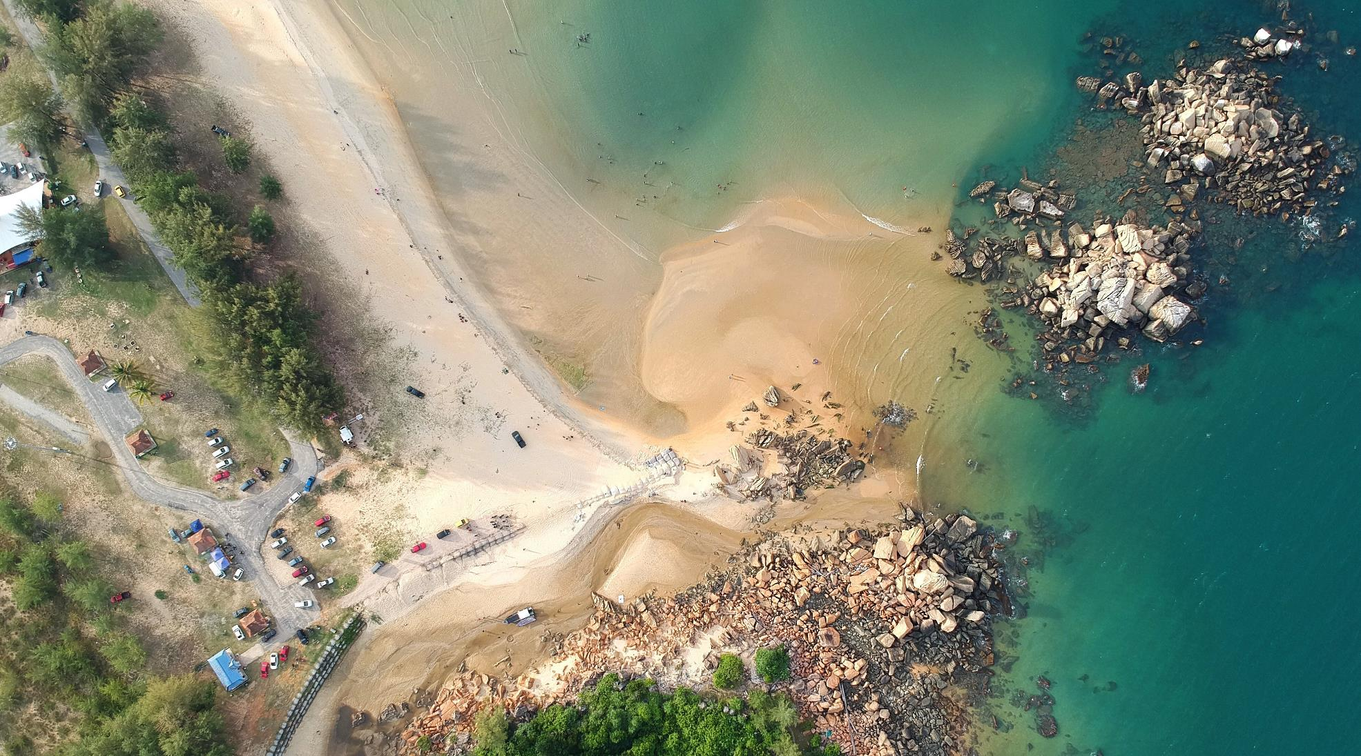
Thank You
Team Slack-Errr
Tableau Public Page:
Project Repo: github.com/SDCraigN/UCB_DAB_Final_Project

